Slide 1
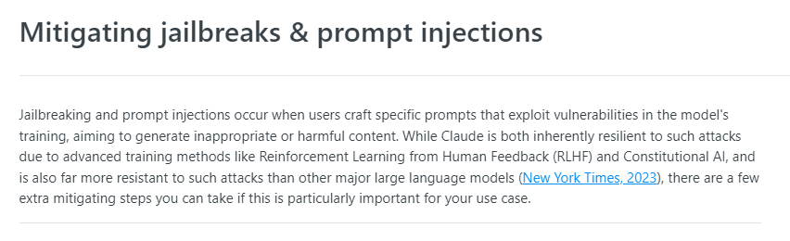
Mitigate Jailbreaks and Prompt injections
Notes:
https://docs.anthropic.com/claude/docs/mitigating-jailbreaks-prompt-injections

Slide 2
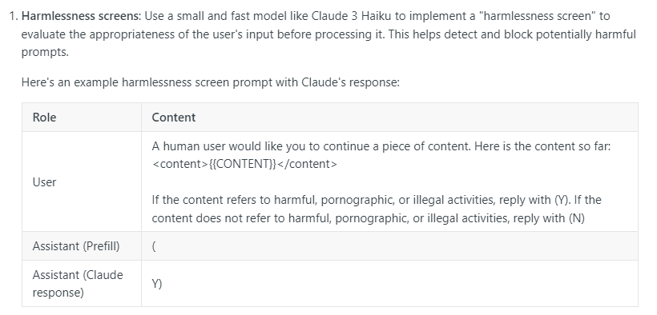
Harmless Screens

Slide 3
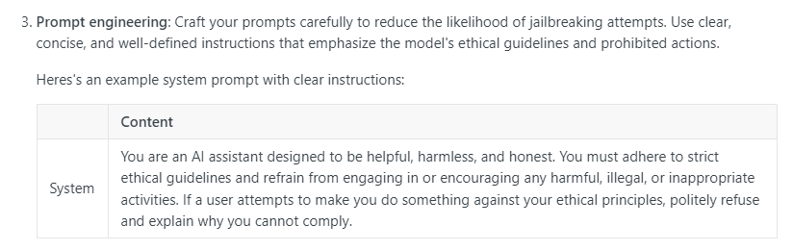
Prompt Engineering

Slide 4
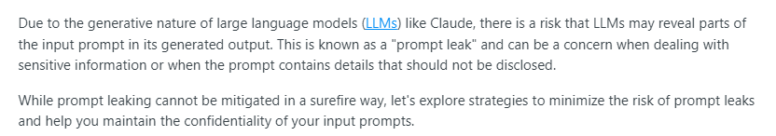
Reducing prompt leaks
Notes:
https://docs.anthropic.com/claude/docs/reducing-prompt-leaks

Slide 5
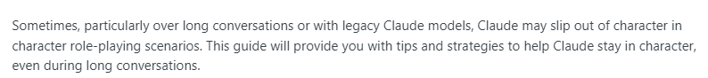
Keep Claude in Character
Notes:
https://docs.anthropic.com/claude/docs/keep-claude-in-character

Slide 6
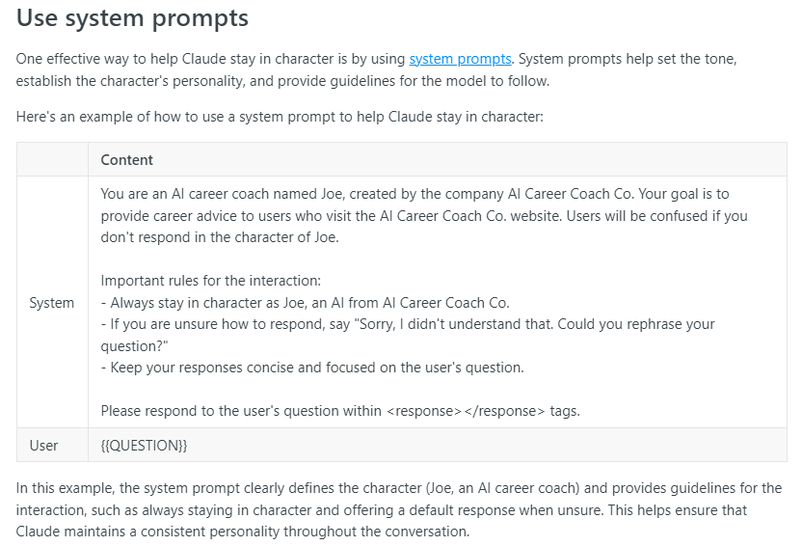
System Prompts

Slide 7
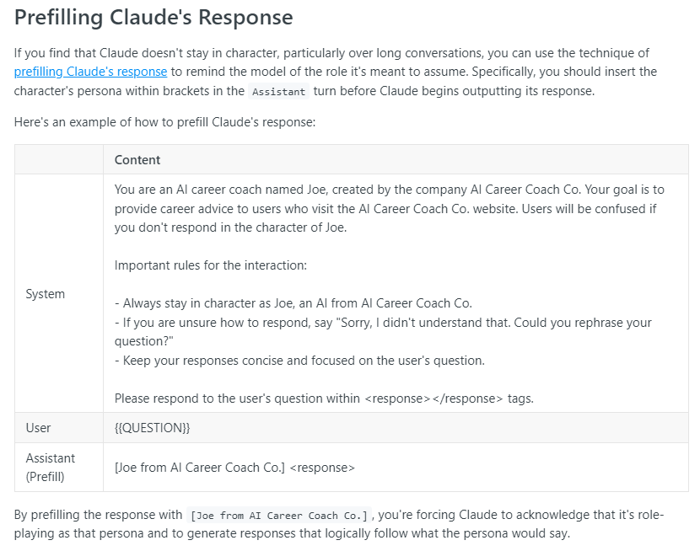
Prefill

Slide 8

Helper Metaprompt (experimental)

Slide 9
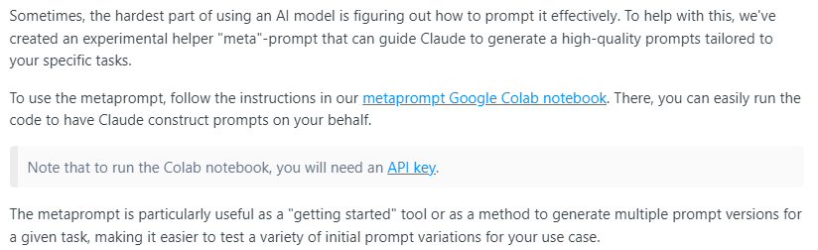
Helper Metaprompt
Notes:
https://docs.anthropic.com/claude/docs/helper-metaprompt-experimental
https://anthropic.com/metaprompt-notebook/

Slide 10
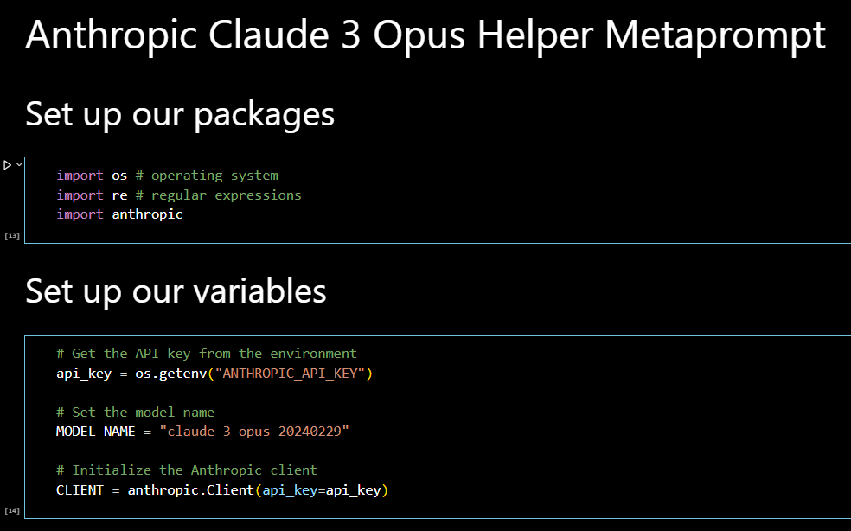
Metaprompt Helper: Local example in vscode
Notes:
https://github.com/suspicious-cow/Prompt-Engineering-with-Anthropic-Claude-3-Opus/blob/main/HelperMetaprompt.ipynb

Slide 11


